Slide 1
Thinking about pixels? (They don’t plug and play)
Les Willis
WillisChristmasShow.com

Slide 2
My background
Electrical Engineer - Retired
Programmer
Many years experience with
Computers
Networking
DIY

Slide 3
My lighting background
Always have had a static light display
2015 Season I did my first light animation to music (using dumb RGB and incandescent)
GCLF
Great Christmas Light Fight
2016 took the full plunge into smart RGB pixels

Slide 4
What do we mean by pixels
Individually addressable
Contain 3 LEDs (Red, Green, Blue)
Millions of color combinations
Require special controllers
Low DC voltage

Slide 5
I Heard the Bells on Christmas Day

Slide 6
Objective
To help understand the various specifications when it comes to smart nodes/pixels. So that you can make an informed decision regarding your pixel choices.

Slide 7
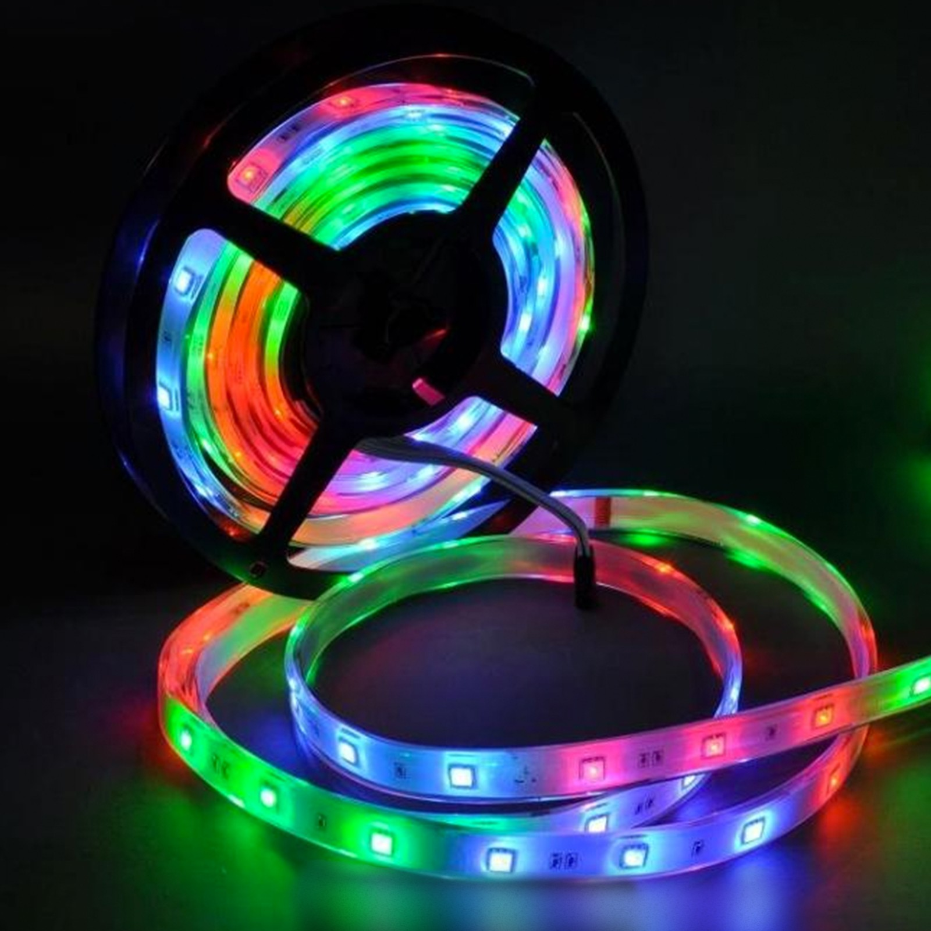
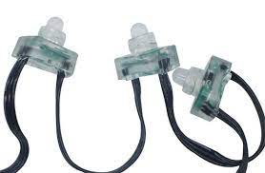
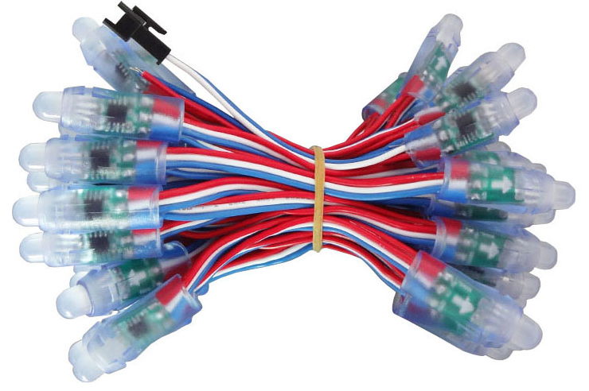
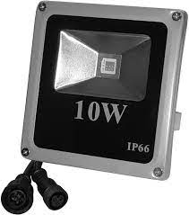
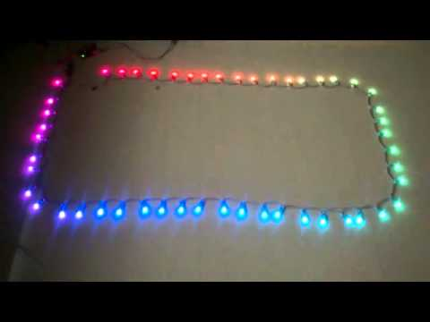
Smart pixel examples
Pixels
Bullet nodes
Beads
Ribbons
Floods

Slide 8
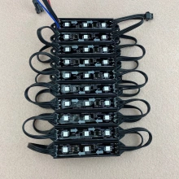
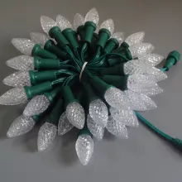
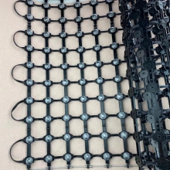
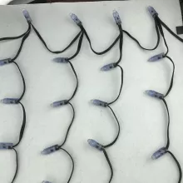
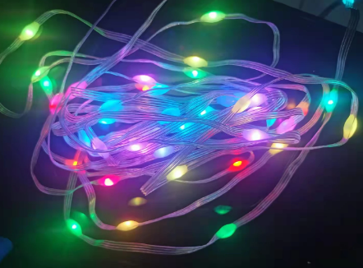
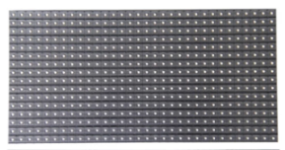
Smart pixel examples
Pixel Module
Drops/Icicles
Mesh/Nets
Fairy lights
C9’s
P10’s

Slide 9
There are no standards (but lots of options)
LED driver circuits
Shapes and sizes
Node Spacings
Power consumption
Connectors
Voltages

Slide 10
LED Driver Circuits
WS2801 / WS2803 WS2811 / WS2812 / TM1804 / TM1803 / TM1809 / TM1812 / SM16715 / INK1003 TLS3001 / TLS3002 / CY3005 LPD6803 / D705 / LPD1101 / USC6909 / UCS6912 GE Color Effects (GECE)
LPD880X APA 102 1903 SM16716 LX1203”

Slide 11
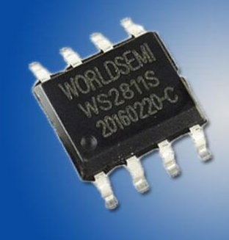
WS2811/2812
The number refers to the integrated circuit (IC) being used to control the LEDs

Slide 12
Styles and spacings
Spacing between pixels for straight runs
Drops/Icicles and Peace stakes
Spacing between drops
Spacing along drops
Length of pigtails
Wire color (Green, Black, White, RWB)

Slide 13
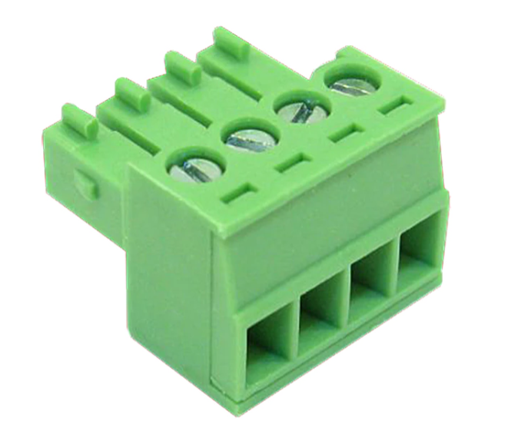
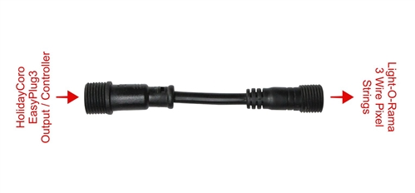
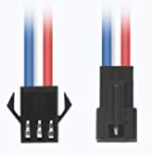
Connectors
Various controllers 3 and 4 pin
Xconnect 13.5 mm
Ray Wu 13.5 mm
Paul Zhang 18 mm
LOR/DIY 15 mm
JST style

Slide 14
Connectors

Slide 15
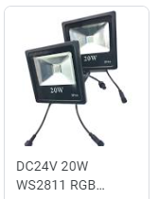
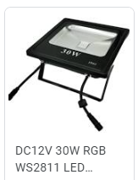
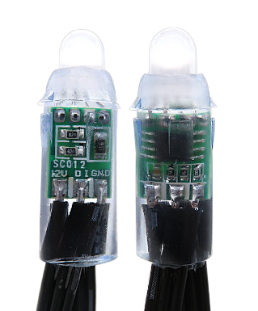
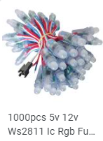
Voltages – 5V and 12 V are most common but pay attention

Slide 16
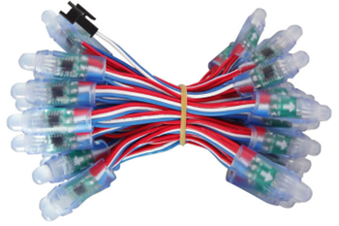
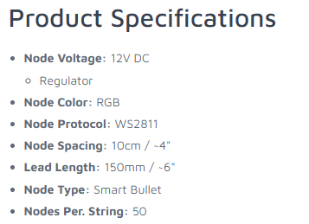
Confirm your product specifications!

Slide 17
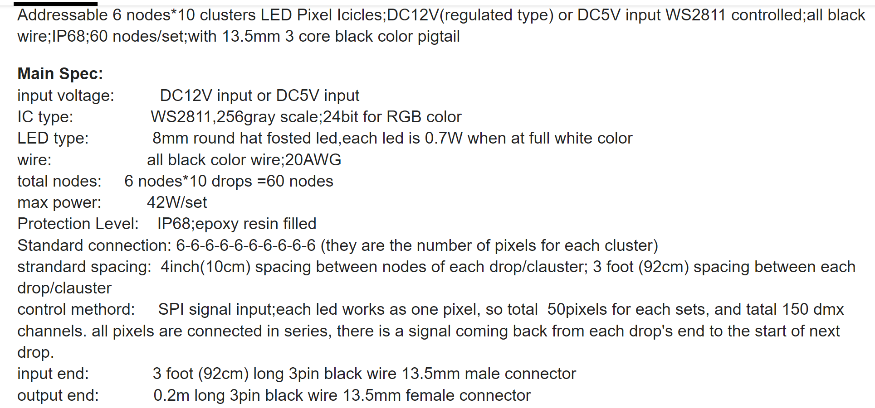
Example for Drops

Slide 18
Questions?

