Slide 1
My lights don’t blink and flash, help!
Les Willis
WillisChristmasShow.com

Slide 2
My background
Electrical Engineer - retired
Programmer
Many years experience with
Computers
Networking
DIY

Slide 3
My lighting background
Always have had a static light display
2015 Season I did my first light animation to music (using dumb RGB and incandescent)
GCLF
Great Christmas Light Fight
2016 took the full plunge into smart RGB pixels

Slide 4
I Heard the Bells on Christmas Day

Slide 5
What makes up a light show?
Props
RGB Pixels (low voltage DC)
Incandescent (120 AC)
DMX devices (moving heads, smoke machines)
Controllers
Computer

Slide 6
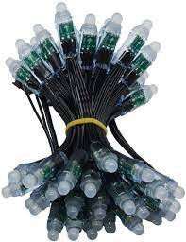
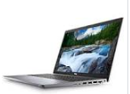
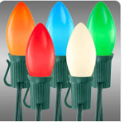
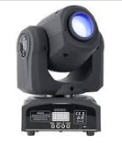
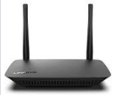
Basic network setup
Cont 1
Computer
Cont 2
Cont 3
Router

Slide 7
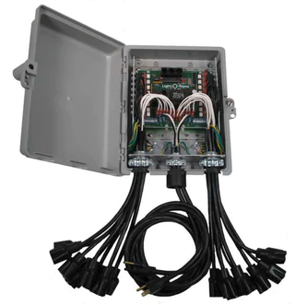
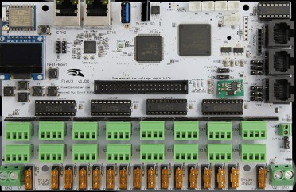
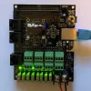
Controllers
LOR
Falcon
Pis/Hats
Beagles/Capes

Slide 8
Basic network setup
Computer
Controller
Router

Slide 9
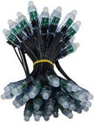
Logical flow
Computer
Sequence
Software
Controller
Lights
Router

Slide 10
Punch list (items to check)
Double check your controller/prop connection
“Ping” your controller/verify network connection
Utilize test features in your controller
Confirm/set controller settings (port, interface, channel/universe
Verify the above settings in your sequence software (controller type, IP address, universes)
Utilize the test features in your sequence software
Start sequencing!

Slide 11
1. Check prop connections
Newer Pixels don’t use
CLK connection
Wrong
Pinched insulation
Wrong
Loose wire
Right!

Slide 12
Find controller IP address
Log into your router
Look on the controller if it will display this
Make sure IP address does not change!

Slide 13
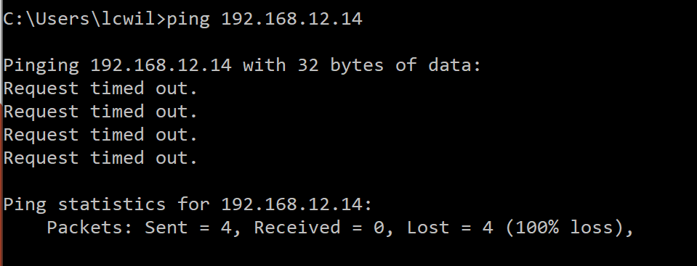
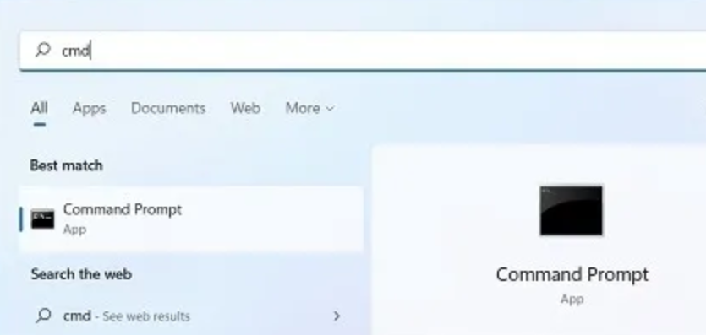
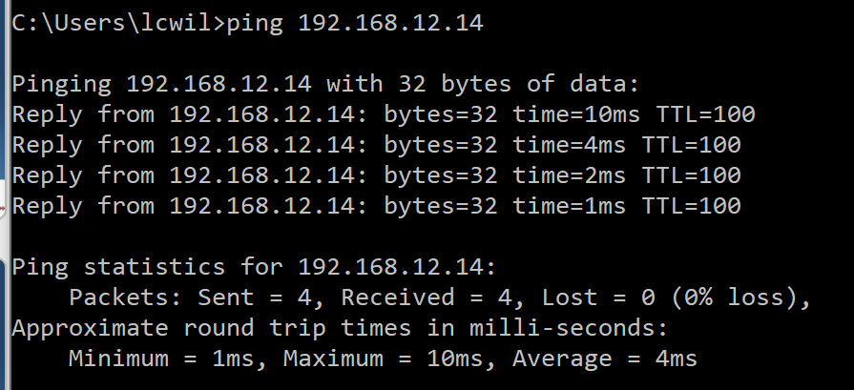
2. Ping your controller
Use the Windows “Command Window” and “Ping” program

Slide 14
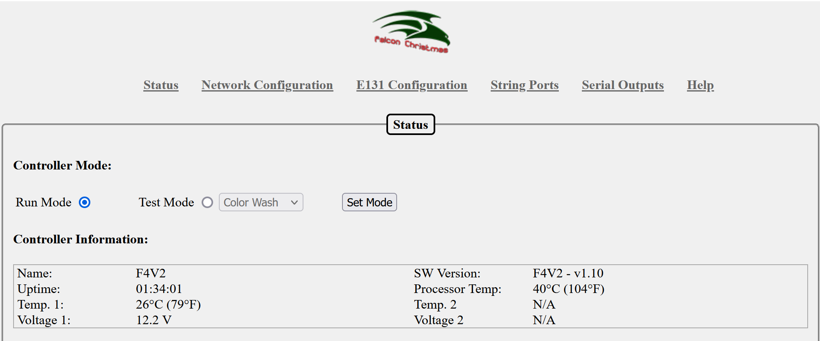
3. Use test features in controller
4. Confirm settings (Universes and ports)

Slide 15
Logical flow
Sequence
Software
Computer
Router

Slide 16
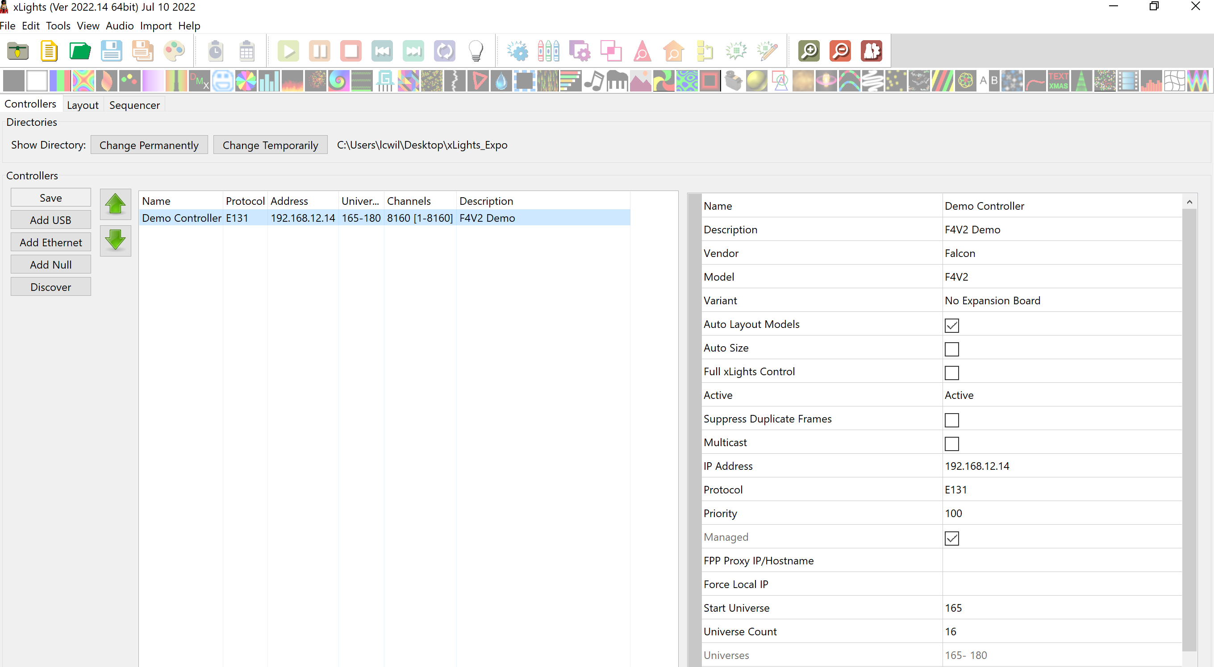
5. Verify settings in your sequence program
6. Use your program’s test features

Slide 17
Check list review
Double check your controller connection to your pixel string(s)
“Ping” your controller (verify network connection
Utilize test features in your controller
Confirm controller settings (port, interface, channel/universe
Verify the above settings in your sequence software (controller type, IP address, universes)
Utilize the test features in your sequence software
Start sequencing!

Slide 18
Questions?

